Slide 1

The 5% Challenges of Test Automation
T
STP Conference 2006
Hans Buwalda
LogiGear Corporation

Slide 2
Scope of this Workshop
Raising the bar for automation
  make it an effective tool in software development
Show techniques, concepts, ideas to achieve the higher bar
How feasible is all of this in practice

Slide 3
Testing Under Pressure
DEADLINE
specification
development
test

Slide 4
Testing Under Pressure
DEADLINE
“CRUNCH ZONE”
specification
development
test
Develop tests in time:
Test design
Auditing, acceptance
Preparations
Automation

Slide 5
Strategic Position of Test Processes
EXTERNAL
INTERNAL
Customers
Management
Vendors
Government
Agencies
Test Development
Quality Assurance
Publicity
Technology/
Infrastructure
Test Automation
End User
Departments
System
Development
Marketing/
Sales
Production
After Sales/
Help Desk

Slide 6
Why Automate Tests?
It is more fun
Can save time and money
  potentially improving time-to-market
Reduces involvement of valuable specialists
  "cans" application business and application knowledge
Consolidates a structured way of working
  when established as integral part of system development process
Speeds up development
  shorter turnaround between changes
  more security

Slide 7
Why not Automate?
Can rule out some of the human elements
  might not find "unexpected" problems
More sensitive to good practices
  pitfalls are plentiful
Creates more software to manage
Needs/uses technical expertise in the test team

Slide 8
Key Issues in Testing
Appropriate Test design
Comprehensive automation architecture
    manageable, maintainable
    control over the technology
Management of the tests
    tests and test scripts are products that need to be managed
Management of the test process
    managers want to know what is going on
Clear and useful reporting
    progress, results
Quality Assurance
    efficient and effective involvement of stake holders, users, auditors

Slide 9
What are Typical Problems
No clear direction
Test design is not well thought through
Automation lacks architecture, is not transparent and hard to manage
Testing is underestimated or avoided
    testing is difficult and expensive
    management is often in denial
    it looks unattractive to spend money on testing
Test automation is underestimated
    test automation can be very difficult
Focus on tools and technology, at the cost of test design

Slide 10
The 5% Challenges
No more than 5% of all tests should be executed manually
No more than 5% of all efforts around testing should involve automating the tests

Slide 11
Rationale 95% Automation
Credible pay-off for automation efforts
Automation will allow to find “bonus bugs”
  on average 15% of fixes cause new bugs
  many of these bugs are hard to find without integral testing
    often a result of violating overall architectures
    the bugs occur because data is left in inconsistent state
The automation should be the core of the testing life cycle
  otherwise it looses ground quickly
  relieve the “crunch zone”
  apart from “exploratory testing”

Slide 12
Rationale 95% Efforts in Testing
Automation should not dominate efforts
  it is not a goal in itself
  may never be a bottleneck
Testers should be able to focus on testing
  better tests (higher ambition level)
  communication with stake holders
High level of effort will aggravate the “crunch zone”
  invitation to Murphy’s law

Slide 13
Approaches to Automation
Record & Playback (or "Capture & Replay")
Scripting (programming)
Action Words (keywords)
see also: "Software Test Automation", Mark Fewster and Dorothy Graham,

Slide 14
Record and Playback
select window "Logon"
enter text "username", "administrator"
enter text "password", "testonly"
push button "Ok"
select window "Main"
push button "New Customer"
expect window "Customer Information"
select field "First Name"
type "Paul"
select field "Last Name"
type "Jones"
select field "Address"
type "54321 Space Drive"
.
.
.

Slide 15
Example Scripting
. . .
Function EnterCustomer(FirstName, LastName, Address)
Click("New Customer");
ExpectWindow("New Customer");
EnterField("First Name", FirstName);
EnterField("Last Name", LastName);
EnterField("Address", Address);
. . .
Click("OK");
End Function
. . .
Function Main()
Logon();
EnterCustomer("Mary", "Jones", "123 Palm Drive");
EnterCustomer("Paul", "Franklin", "321 Regent Street");
. . .
LogOff();
End Function
. . .

Slide 16
Automation Success Factors
Accessible and maintainable test structure
High degree of automation
High re-use
At least as maintainable as the system under test
Test specification separate from automation
  At the same time avoiding double work between tester and engineer

Slide 17
Action Based Testing
Provides a framework for effective automation
Based on a notion that a test can be broken down in a number of consecutive actions
Both actions and their data are in products, called "Test Modules"
  Excel spreadsheets for easy development and communication
  test data is explicit or with a place holder
  explicit checks with specified expected result values
  most actions are "high level", omitting as many unneeded details as possible
Instead of implementing test cases, the automation engineer concentrates on the programming individual actions
We will assume use of ABT in the rest of this presentation
  mostly for terminology and frame of reference
  not dismissing other methods, which can possibly achieve the same success

Slide 18
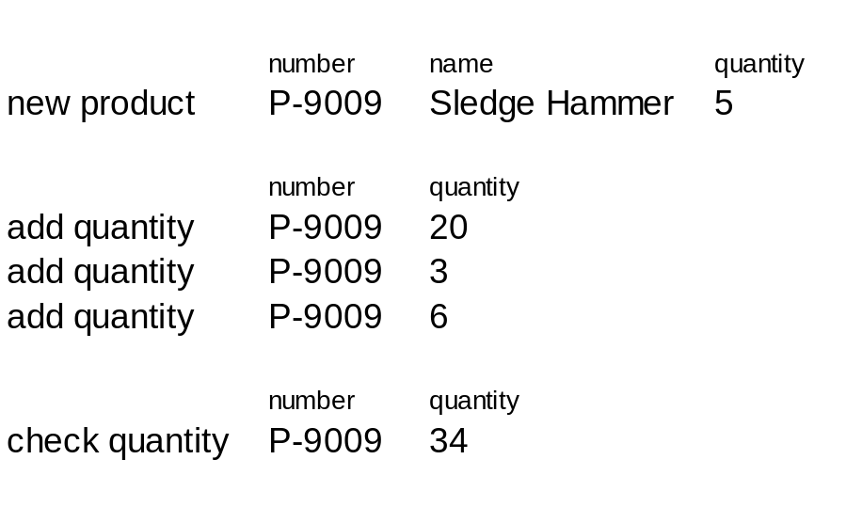
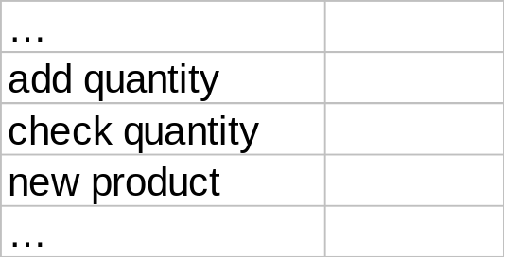
Separation of Tests and Automation
Test Module
(Excel Spreadsheet)
Automation

Slide 19
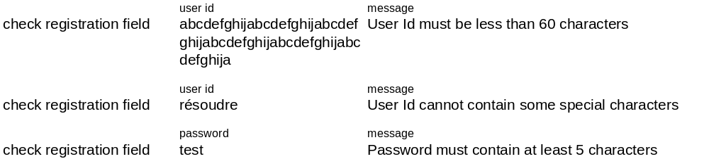
Example of "Old and New" Formats
Most values are implicit. The tester has to figure out during execution….
Same instruction repeated over and over again…
Current format
Enter a User Id, which is greater than 60 characters and enter proper information for all other fields and click on the "Continue" button | Error message should be displayed with "User Id must be less than 60 characters".
Enter a User Id with special character's) and enter proper information for all other fields and click on the "Continue" button | Error message should be displayed indicating the "User Id cannot contain some special characters".
Enter the information, with a password of 4 characters and click on the "Continue" button | Error message should be displayed with "Password must contain at least 5 characters".
ABT format

Slide 20
What Does an Action Do?
A typical action does one of the following:
  Sending to the application under test inputs such as a mouse click event or data to an input field
  Capturing and checking output information from the application under test
  Setting context such as initialization, configuring the toolset and/or the test environment
  Anything else the tester may desire . . .

Slide 21
Implementing Actions
Actions are implemented in either one of three ways:
  built-in in the tool (in our case TestArchitect)
  defined in an “Action Definition”, expressed with other “lower level” actions
    similar to functions in a programming language
  programmed in a programming or scripting language
To address the interface we use “Interface Definitions”
  purpose is to shield from specific, and volatile, properties of windows and controls of the GUI

Slide 22
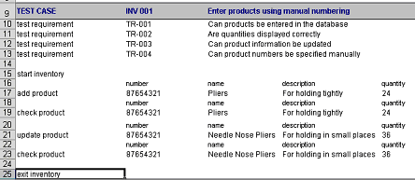
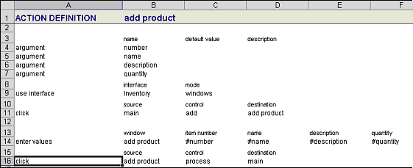
Action Definitions
STEP 1
STEP 2
Interface
Nested
Actions

Slide 23
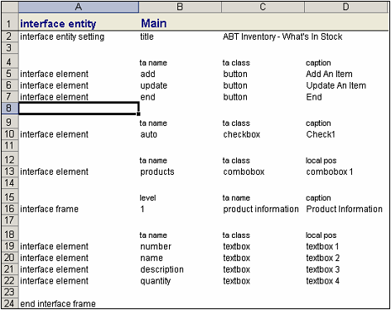
Interface Definition
STEP 3
Interface
Interface Entity
Interface Element

Slide 24
Overview
Test Development
Automation
Policies
Test Design
Action
Definitions
Planning
Budget
Stake Holders
Experts
Test
Module
Auditors
Test and
Action
Repository
Interface
Definitions
Test
Requirements
Requirements
Risks
Ambition level
Skills
Generic Low
Level Scripts
Experiences
Test Lines
(with Actions)
Insights
Techniques
Web Based
Applications
Standards
File Based
Applications
API's /
Embedded
GUI Based
Applications
Character Based
Applications
Protocol Based
(TCP/IP, SS7, ...)
Databases

Slide 25
Achieving the Challenges...
Three major success factors:
Test design
Automation architecture
Organization

Slide 26
Test Design
Effective test breakdown (into test modules)
  make sure every test has a clear focus
  keep different kinds and levels of tests separate
Right level of actions
  as “high level” if possible, hiding as many details as much as possible
  but not if the details are relevant for the test
It is my believe that test design, not automation or “the tool”, is the deciding factor in achieving the 5% challenges

Slide 27
Breakdown: Divide and Conquer
Mission, Priorities, Information, Planning, Budget, Stakeholders, ...
Breakdown
Priority and planning
what
when
who
how
development
development
development
development
execution and follow up
execution and follow up
execution and follow up
execution and follow up
maintenance
maintenance
maintenance
maintenance

Slide 28
Breakdown "Cheat Sheet"
Straightforward Criteria
  Architecture of the system under test (which part are we testing)
  Functionality and other requirements
  Kind of test (navigation flow, quality attributes, ...)
  Ambition level (smoke test, regression, requirement based, aggressive, …)
Additional Criteria
  Stakeholders
  Complexity of the test
  Technical aspects of execution
  Planning and control
  Risks involved

Slide 29
Levels of Actions
High level actions to hide details
  to hide unneeded details
    always hunt down details
  implemented in terms of lower level actions
Low level actions to access the automation technology
  either built-in in a tool like TestArchitect
  or create yourself in a “harness”
    this is the only real programming you would do

Slide 30
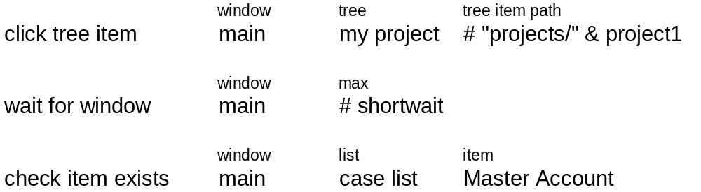
Example of “Going High Level”

Slide 31
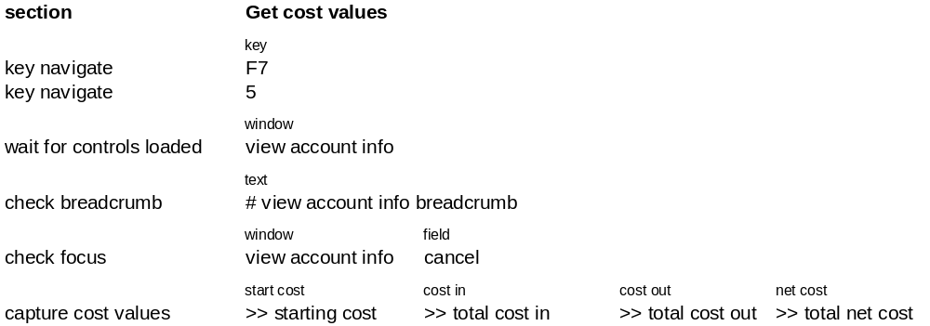
Example of “Going High Level”

Slide 32
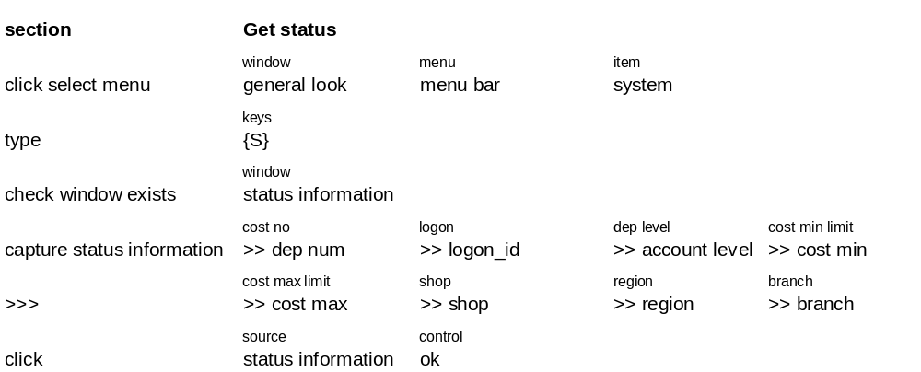
Example of “Going High Level”

Slide 33
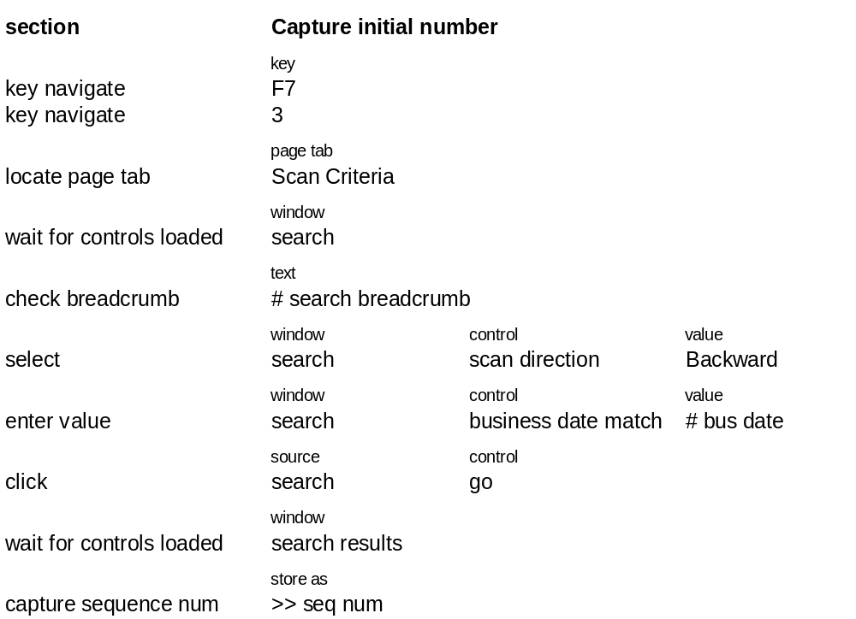
Example of “Going High Level”

Slide 34
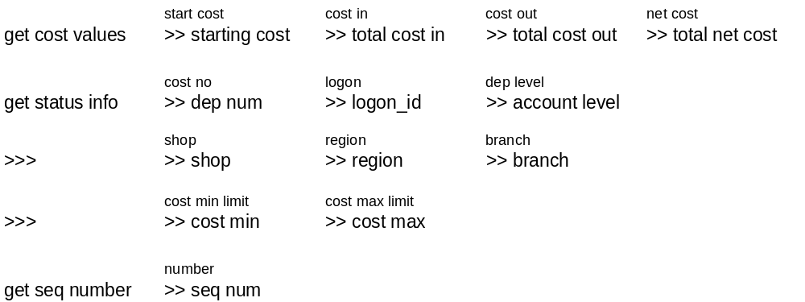
Example of “Going High Level”

Slide 35
When to Program Actions
Program actions for:
  specific technical needs of the system under test
  complex actions
    typically when loops get involved
Make programmed actions:
  generic, maximum re-use
  atomic, only one small task per action
Avoid programming high level actions
  split them up in lower level actions, some of which you program

Slide 36
“Atomic and Generic”
Even though harness actions are custom, make them:
  atomic, only one small task per action
  generic, maximum re-use
Avoid programming test cases or high level actions
  split them up in well-defined low level actions

Slide 37
Automation Architecture
Pay attention to where and how to implement actions
  using the “action definitions” (or something similar) for straightforward actions
  use programming for
    complex actions (typically involving loops)
    wrap specific technical code to access the interface
Select the right tools and technologies
  some of the considerations are subtle
  technical choices strongly influence the ease of the automation
  make sure the technology is organized as durable/re-usable as possible
  Go for a “mix” of technologies (UI, API’s, SQL, TCP/IP, ...)
Manage the handling of the interface (UI, API, ...)
  make sure all dialogs, pages, controls etc get meaningful “logical” names (mapped to the actual items in the UI etc)
  let the developers help you if necessary by providing easy to identify properties of UI elements (for example the “id” in Web apps, and “AccessibleName” in .Net”)

Slide 38
Select Tools and Technologies
Technical choices strongly influence the ease of the automation
  some of the considerations are subtle, invest some thinking
  often the technology is not the deciding factor, but the way you package it is
Make sure the technology is organized as durable/re-usable as possible
Go for a “mix” of technologies (UI, API’s, SQL, TCP/IP, ...)

Slide 39
Multiple System Access
Test Modules, driving either one or multiple interfaces
ABT Multilevel Automation Scheme
System (part)
Under Test
protocol
access
UI
access
direct api
access
database
access

Slide 40
Testing Embedded Software
Automation
Target
ABT
Automation
Mini
Agent
Interface
Info
Software Under Test

Slide 41
Testing a Protocol
Automation
SEND
World Under Test
Interface
Definitions
RECEIVE
stash

Slide 42
Handling Batch Processes
Test Module
Transfer Jones Williams 100
Check Balance Jones -100
Check Balance Williams 100
1
Batch Input File
Jones Williams 100
2
1
Batch Run
2
"Delayed Checks" Module
Batch Output File
3
D Check Balance Jones -100
D Check Balance Williams 100
Jones -100
Williams 100

Slide 43
Organization
Much of the 5% success is also gained or lost in how you organize the process
Write a plan of approach:
  scope, assumptions, risks, planning
  methods, best practices
  tools, technologies, architecture
  stake holders, including roles and processes for input and approvals
  team
  . . .
Assemble the right team
  testers, lead testers
  automation engineer(s)
  managers, ambassadors, ...
see also:
“QA All-Stars: Building Your Dream Team”, Hans Buwalda, “Better Software” September 2006

Slide 44
Are the 5% rules Achievable?
To achieve to high automation coverage tends to be fairly straightforward
  once the actions work all tests are automated
  don’t settle for too little
The automation efforts need to be well managed, but then can be kept low as well
  need of automation specialization and intelligence in the team
  a method like ABT can provide a proper framework, but is only a start
The key to success is: think it through
  don’t hesitate to revisit your design and automation
  make sure the tests are easy to run

Slide 45
Typical Time Allocation
TEST DEVELOPMENT
efforts
AUTOMATION
time

Slide 46
Summary
Set aggressive targets for the automation,
  it costs money and efforts
  it should not get in the way of the testers making good tests
Elements for success:
  test design
  automation architecture
  organization
Focus on the method first
  the “tool” is only a minor element
  use some form of keyword driven method like ABT
The 5% targets can be achieved:
  automation coverage can even reach 100%
  to limit efforts (to 5% of all efforts) requires serious planning and thinking ahead

